Slide 1
Processes and Host Security
Lecture 8
CoSc2043 – Network and System Administration

Slide 2
Lecture Overview
UNIX Processes
Running programs
Monitoring processes
Killing processes.
Why Security?
System Security Issues
Network Security Issues
Physical and Session Security Issues
Security Implementation

Slide 3
Programs & Processes
Program – file which can be run
  Binary executables
  Shell scripts
Process – A running program
  Loaded in physical memory
  Stored in virtual memory (swap)

Slide 4
Virtual Memory
Extends amount of physical memory
UNIX
  Size of swap = amount of usable memory
  Physical memory (RAM) mirrored in swap
Linux: Memory = swap + RAM
Swapping
  Moving pages to and from memory
  Page – block (unit) of RAM

Slide 5
Swap Allocation
BSD UNIX:
RAM:
Swap:
AT&T SVR4/Linux:
RAM:
Swap:
Windows: C:\pagefile.sys (Grows as needed)
Which works better when?
Notes:
Paging
■ Allows processes to be comprised of a number of fixed size blocks, called pages
■ Program references a word by means of a virtual address
■ consists of a page number and an offset within the page
■ each page may be located anywhere in main memory
■ Provides for a dynamic mapping between the virtual address used in the program and a real (or physical)
address in main memory
Swapping
• The process of moving some pages out of main memory and moving others in, is called swapping.
• A page fault occurs when the CPU tries to access a page that is not in main memory, thus forcing the CPU to wait for the page to be swapped in.
• Since moving data to and from disks takes a significant amount of time, the goal of the memory manager is to minimize the number of page faults.

Slide 6
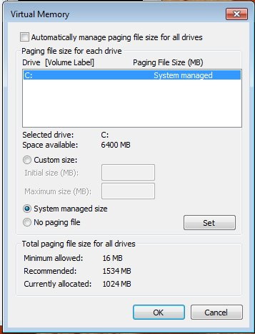
Windows pagefile.sys Settings
Notes:
Demand paging is essentially a way that the operating system can substitute space on the hard disk for actual RAM. This is accomplished by the Memory Management Unit (MMU) on the CPU
It also has another role: storing the information about the computer's state in case there's a crash or a power cut.

Slide 7
Process Lifecycle
Wait
I/O
Request
I/O Completed
Scheduler
Dispatches
New
Admitted
Ready
Run
Interrupt
Exit
Done

Slide 8
Process Components
Address space map
Status
Owner
Blocked Signals
Priority
Resources used
  Running
  Runable
  Sleeping
  Stopped
  Zombie
Notes:
In Unix/Linux operating systems, processes can be in one of the following states:
1. RUNNING & RUNNABLE
2. INTERRRUPTABLE_SLEEP
3. UNINTERRUPTABLE_SLEEP
4. STOPPED
5. ZOMBIE
RUNNING & RUNNABLE
When the CPU executes a process, it will be in a RUNNING state. When the process is not waiting for any resource and ready to be executed by the CPU, it will be in the RUNNABLE state.
SLEEPING
SLEEPING state indicates the process is currently waiting on certain resources (like waiting on I/O, waiting on locks, application code making the process to sleep,…). There are two types of SLEEPING processes:
INTERRUPTABLE_SLEEP: When a process is in INTERRUPTABLE_SLEEP, it will wake up from the middle of sleep and process new signals sent to it.
UNINTERRUPTABLE_SLEEP: When a process is in UNINTERRUPTABLE_SLEEP, it will not wake up from the middle of sleep even though new signals are sent to it.
How to kill the SLEEPING Process ?
If the process is in INTERRUPTABLE_SLEEP state, then issuing SIGKILL signal (i.e. ‘kill -9’) to the process, will terminate the process immediately. On the other hand, if the process is in UNINTERRUPTABLE_SLEEP state, then the issuing SIGKILL signal will not terminate immediately. Only after the process completes its sleep/waiting operation it will terminate. Thus, if you would like to kill a process which is in UNINTERRUPTABLE_SLEEP state for a prolonged period then you have to reboot the system, there is no other way.
STOPPED
STOPPED state indicates that the process has been suspended from proceeding further. In Linux when you issue the ‘Ctrl + Z’ command it will issue a SIGSTOP signal to the process. When the process receives this signal it will be suspended/stopped from executing further. When a process is in STOPPED state, it will only handle SIGKILL and SIGCONT signals. SIGKILL signal will terminate the process, but the SIGCONT signal will put the process back into RUNNING/RUNNABLE state.
ZOMBIE
A process will terminate when it calls ‘system exit’ API or when someone else kills the process. When a process terminates, it will release all the data structures and the resources it holds. However, it will not release its slot in the ‘process’ table. Instead, the process will send a SIGCHLD signal to its parent process. Now it’s up to the parent process to release the child process slot in the ‘process’ table. The process will be in ZOMBIE state from the time the child process issues the SIGCHLD signal until the parent process releases the slot in the ‘process’ table.
How to kill the ZOMBIE Process?
Issuing ‘kill -9’ on a Zombie process Id, it will not affect because ZOMBIE process doesn’t exist. However Zombie Process can be killed by sending a SIGCHLD signal to the parent process, using the below kill command:
kill -s SIGCHLD parent-pid
This signal tells the parent process to execute the wait() system call and clean up its zombie process.
NOTE: Sometimes if the parent process isn’t programmed properly to handle SIGCHLD signals, then the above command will not work. You have to kill the parent process of the zombie process.
How to find the process state?
You can find the process state from the following source:
a. Unix/Linux command-line tool ‘top’ will report the process state in the column ‘s’. Process status is reported with a single character.
R – RUNNING/RUNNABLE
S – INTERRRUPTABLE_SLEEP
D – UNINTERRUPTABLE_SLEEP
T – STOPPED
Z – ZOMBIE
linux

Slide 9
Process Ownership
Real User (User starting the process)
  UID: User ID Number
  GID: Group ID Number
Effective User (Permissions for process)
  EUID: Effective User ID Number
  EGID: Effective Group ID Number
Notes:
pid: The is the process ID (PID) of the process you call the Process.pid method in.
ppid: The PID of the parent process (the process that spawned the current one).
For example, if you run ruby test.rb in a bash shell, PPID in that process would be the PID of Bash.
uid: The UNIX ID of the user the process is running under.
euid: The effective user ID that the process is running under.
The EUID determines what a program is allowed to do, based on what the user with this UID is allowed to do.
Typically the same as uid, but can be different with commands like sudo.
gid: The UNIX group ID the program is running under.
egid: Like euid, but for groups.

Slide 10
Process Lifecycle
Parent process “forks” a child
Process identifiers
  PID: Process ID Number
  PPID: Parent Process ID Number
Child finishes
  Sends status message to parent
  Zombie – waits for parent acknowledgment
  Orphan – init (PID 1) becomes parent
Notes:
a zombie process or defunct process is a process that has completed execution (via the exit system call) but still has an entry in the process table
This occurs for the child processes, where the entry is still needed to allow the parent process to read its child's exit status: once the exit status is read via the wait system call, the zombie's entry is removed from the process table and it is said to be "reaped“
An orphan process is a computer process whose parent process has finished or terminated, though it remains running itself. In a Unix-like operating system any orphaned process will be immediately adopted by the special init system process: the kernel sets the parent to init. This operation is called re-parenting and occurs automatically

Slide 11
Running a command
Type in the command name
Shell searched for the command
If found, shell “forks” the command
How is the command found?
  PATH environment variable
  which – Displays full path to command
  Beware of “.” in your PATH
Notes:
The PATH environment variable is an important security control. It specifies the directories to be searched to find a command. The default systemwide PATH value is specified in the /etc/profile file, and each user normally has a PATH value in the user's $HOME/.

Slide 12
Background Jobs
Foreground process
  Returns control to shell after it finished
  Most common usage
Background process
  Returns control to shell immediately
  “&” typed after command name
  Runs concurrently

Slide 13

Daemons
Special programs which performs a some task without intervention
Started in the background
  (often at system startup)
Name of most ends in ‘d’
“Daemon” is actually a much older form of “demon”; daemons have no particular bias towards good or evil, but rather serve to help define a person's character or personality.
~Evi Nemeth

Slide 14
fg, bg, & jobs
Can switch between modes
Send signal to stop a process
Commands
  fg – Run process in foreground
  bg – Run process in background
  jobs – List shell child processes

Slide 15
Signals
Used to communicate with processes
Terminal signals
  <Ctrl><c> - Terminate process
  <Ctrl><z> - Stop (suspend) process
kill [-signal] pid
  Sends signal to process PID
  Default is to terminate the process

Slide 16
Common Signals
# | Name | Description
1 | HUP | Hangup
2 | INT | Interrupt
3 | QUIT | Quit
9 | KILL | KILL
15 | TERM | Software Termination
 | STOP | Stop

Slide 17
Process Priority
How much CPU time granted relative to other processes
nice – Sets the priority value at start
renice – Changes priority
Ranges
System | Range
Solaris | 0 to 39
RedHat | -20 to 20

Slide 18
System Load
Average number of “Runnable” processes
Measure of how busy the system is
Performance deteriorates at loads of 6+
Good for creating a baseline
uptime – Load average
  (5, 10, 15 minutes)
Notes:
uptime shows how long the system has been running, number of users together with load averages:
High load averages imply that a system is overloaded; many processes are waiting for CPU time.

Slide 19
Monitoring Processes (Linux)
ps
  BSD – Sorts by %CPU Usage
  SVR4 – Sorts by PID
top
  Full terminal screen display
  Sortable
  Can kill and renice processes

Slide 20
Information from ps
PID
USER
PRI/NI - Priority/Nice level
RSS/SIZE - Resident/Total Memory used
STAT - Process State
%CPU/%MEM - % of System CPU/Memory
TIME - CPU time used
Command

Slide 21
/proc Filesystem
Pseudo filesystem
Interface to memory-related kernel data structures
Each PID has it’s own directory
  cwd – Symlink to current working directory
  exe – Symlink to program
  cmdline – command line options
  environ – command line environment
  stat – process status

Slide 22
Monitoring Processes (Windows)
Task Manager
  Graphical viewer
  Can also sort or kill processes
tasklist
  Command line Viewer
  Can view associated dll files
wmic process [options]
  Can view, start, and kill processes
  Remote connection capabilities

Slide 23
SysInternals - Process Tools
Command Line tools
  Pslist – display running processes
  Pskill – Kill processes by name or PID
  Psexec – Run programs remotely
GUI Tools
  Procmon – Detailed process info
  RAMMap – View RAM usage
  VMMap – View Virtual Memory usage

Slide 24
Runaway Processes
Can eat up your resources
Lists users and PIDs accessing a resource
  fuser
  lsof
Kill the process and clean up
Notes:
A ``runaway process'' is a process that enters an infinite loop and spawns new processes. This can cause an overflow in the proc table that causes other processes to fail with the No more processes: error message

Slide 25
Elevating Access
Principle of Least Privilege
su [-] <user> - “Switch user”
  Requires user password if not run as root
  ‘-’ runs a subshell owned by user
Microsoft runas (Automatic Popup Win7)
Sudo – Run programs as superuser
  /etc/sudoers – who can run what
  visudo – Editor for /etc/sudoers
  sudo – Used to run commands as root
  Windows version available
Notes:
If you prefix “sudo” with any linux command, it will run that command with elevated privileges. Elevated privileges are required to perform certain administrative tasks.
The visudo command opens a text editor like normal, but it validates the syntax of the file upon saving. This prevents configuration errors from blocking sudo operations, which may be your only way of obtaining root privileges. Traditionally, visudo opens the /etc/sudoers file with the vi text editor.

Slide 26
Why Worry about Security?
Y2K Bug – 1/1/2000
DDoS Attack of Yahoo, CNN – 2/2000
Microsoft break-in – 10/2000
SPAM and Phishing
Viruses and Worms
  Internet Worm – 11/1988
  Melissa/ILoveYou Viruses – 1999 - 2000
  CodeRed/Nimda/Slammer/Sobig – 2001-2003
  MyDoom,Netsky/Bagel – 2004
  Stuxnet - 2010
  SPAM/Virus Writer Connection
Terrorist Attacks/Katrina
Numerous Web Defacements
Mobile Computing?

Slide 27
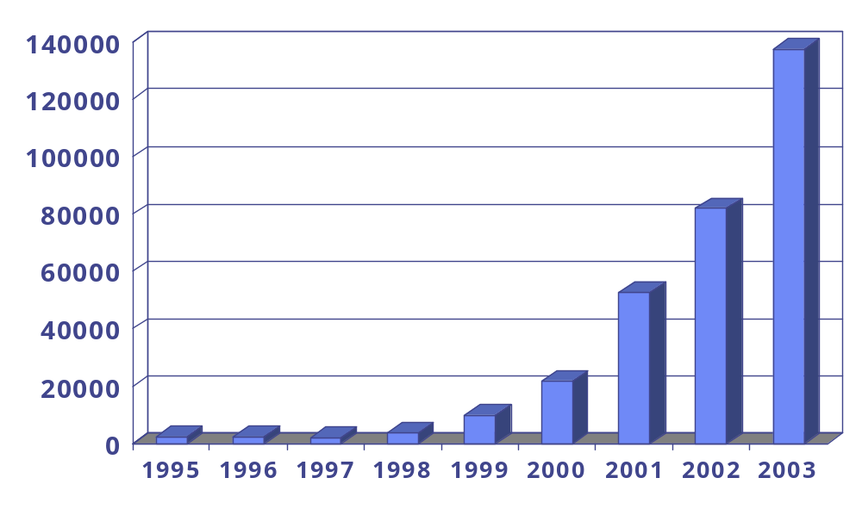
Reported Incidents
Source: CERT

Slide 28
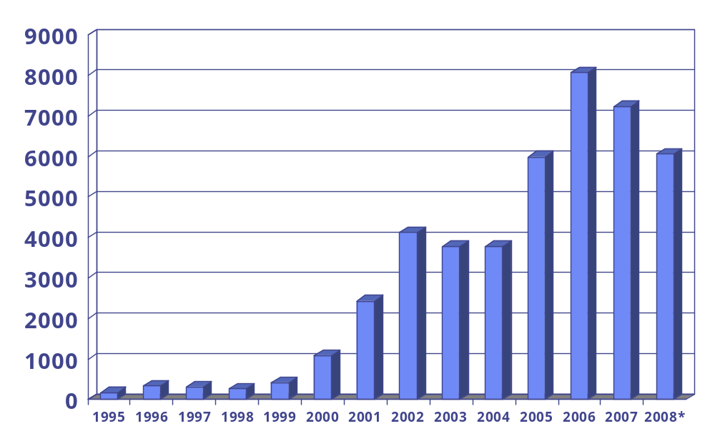
Reported Vulnerabilities
Source: CERT

Slide 29
Threat Pyramid
Governments
100’s
Aggressive
1K’s
Moderate
10K’s
Script
Kids
1M’s
Source: Tom Perrine, SDSC
Security as Infrastructure
Notes:
script skid is an unskilled individual who uses scripts or programs, such as a web shell, developed by others to attack computer systems and networks and deface websites

Slide 30
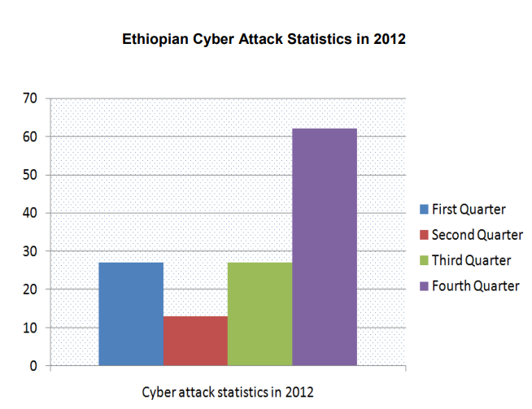
2012 Eth.C Cyber attack

Slide 31
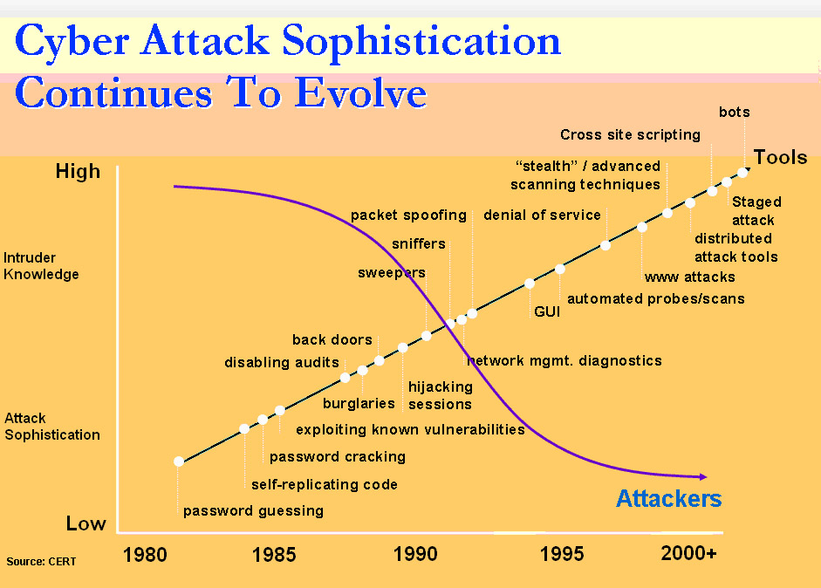
Treat Evolution
Source: CERT (Phishing Exposed)

Slide 32
How much security?
Security
Ease of Use
Beware of Security through Obscurity!!!

Slide 33
Password Security Issues
Low-tech password grabbing
  Social Engineering
  Dumpster Diving
  Shoulder Surfing
Password Cracking
  Encrypted passwords accessible
  Brute force & dictionary attacks
    Alec Muffett’s Crack
    John the Ripper
    Cain and Able
    Rainbow Cracking
Notes:
social engineering is the psychological manipulation of people into performing actions or divulging confidential information.
“Dumpster diving” means searching trash for useful information.
looking over the victim's shoulder,
trying thousands or millions of likely possibilities, such as words in a dictionary or previously used passwords
a brute-force attack consists of an attacker submitting many passwords or passphrases with the hope of eventually guessing a combination correctly.

Slide 34
Password Risk Minimization
User Education!!!
Password Accessibility (/etc/shadow)
Allow for longer passwords
One-Time Passwords – OPIE/SecurID
Password aging
  Forces periodic changing of password
  Accounts locked if password expires
Centralized Authentication
  Kerberos
  Active Directory Services (ADS)
Notes:
The /etc/shadow file stores actual password in encrypted format
Kerberos (/ˈkɜːrbərɒs/) is a computer-network authentication protocol that works on the basis of tickets to allow nodes communicating over a non-secure network to prove their identity to one another in a secure manner.
With a single network logon, administrators can manage directory data and organization throughout their network, and authorized network users can access resources anywhere on the network

Slide 35
/etc/shadow Fields
Username
Encrypted password
Day last changed
Minimum # days between changes
Maximum # days between changes
Notify # days before account expires
Account Inactivation
  Expire # days after max change (Linux)
  Expire after # days of inactivity (Solaris)
Expiration day
Flags (unused)
Example: sorr:lYi8.KpsFAb9M:11262::90:7:12784:

Slide 36
Account Management
Principle of least privilege
Restrictive default umask
Disable/remove inactive accounts
No shared group accounts
Careful placement of ‘.’ in PATH
Same username/UID assignment on all systems on a local network
Notes:
umask is a command that determines the settings of a mask that controls how file permissions are set for newly created files

Slide 37
Root Account Management
Restrict root logins to console
Used only when needed
  su –
  sudo
Avoid multiple root accounts (UID: 0)
Avoid ‘.’ in PATH
Be Careful!!!

Slide 38
System Configuration
Keep all software up to date
  Updates
  Patches
Remove unneeded software
Minimize SUID/SGID programs
Kernel options
System-wide defaults
System Hardening
  SELinux
  CIS Benchmark Tools
  Microsoft: Baseline Security Analyzer
Notes:
A program that changes its UID is called a SUID program (set-UID); a program that changes its GID is called a SGID program (set-GID).
Kernel options (also called kernel parameters) are used to supply the kernel with information about hardware parameters that the kernel would not be able to determine on its own, or to avoid/override the values that the kernel would otherwise detect.
Hardening is usually the process of securing a system by reducing its surface of vulnerability

Slide 39
Pluggable Auth. Modules
System-wide authentication defaults
Authentication management
Account management
Session management
Password management
Notes:
A pluggable authentication module (PAM) is a mechanism to integrate multiple low-level authentication schemes into a high-level application programming interface (API).

Slide 40
Filesystem Protection
Check for…
  World-writable files/directories
  World-readable files/directories
    System configuration files
    Log files
  Ownerless files/directories
  SUID/SGID programs
Filesystem access restrictions
Trojan horses & root-kits
  Modified system files/programs
  Integrity Checkers: Tripwire, AIDE, Osiris
Filesystem Encryption (CFS, EFS)

Slide 41
Network Service Security
Remove unneeded services
  RC Scripts
  inetd/xinetd
Upgrade/Patch active services
Port Scanners – nmap, Saint, Nessus
Service Attack Detection/Protection
  Intrusion Detection Systems (Snort)
  TCP Wrappers
  Firewalls
  Network Address Translation (NAT)

Slide 42
Network Traffic Issues
Packet Sniffing
  See all traffic (passwords, email, etc.)
  Tools: Tcpdump, Wireshark
Spoofing and Session Hijacking
Network Session Encryption
  Telnet, ftp, X11: Secure Shell (ssh)
  Email, Web: Secure Socket Layer (SSL)
  Virtual Private Networks (IPSec/SSL)

Slide 43
Physical Security
Environmental Concerns
Facility Security
  Hardware cables
  Locks (Key, Code, Biometrics)
  Alarms (Theft, Movement, etc.)
Removable media
System BIOS
  Passwords
  Boot device order
Boot Loader Passwords

Slide 44
Session Security
X-Windows
  Remote Applications
  Remote viewing of your windows
  xhost/xauth access control
Console locking
  GUI Screensavers
  Text console(s) – vlock
Shell inactivity timeout

Slide 45
Implementing Security
Risk Assessment
Policy Development
Implementation
Testing
Monitoring/Responding to Incidents

Slide 46
Risks and Policies
Risk Assessment
  Identifying assets, vulnerabilities, threats
  Prevention Cost <> Lost/Recovery Cost
Policy Development
  “That which is not permitted is prohibited”
  Grant authority to enforce policy
  Periodic reviews
  Be positive

Slide 47
System Testing
Password Checkers
Vulnerability Checkers
  System: COPS, Titan, Tiger
  Network: Saint (SARA), Nessus, nmap
Bug Exploits
  Script Kiddie sites (i.e. www.rootshell.com)
  Full Disclosure Email Lists (i.e. BugTraq)
  Security Advisories (i.e. CERT)

Slide 48
Log Monitoring
Baseline Anomalies
  Weird su/root login entries
  Unscheduled Reboots/Service restarts
  Inconsistent login times/locations
Logfile Anomalies
  Strange timestamps
  Incorrect ownership or permissions
  Short, incomplete, or missing logs
Centralized logging

Slide 49

Incident Response
Isolate the system
Understand what happened - Forensics
  Active system analysis
  Filesystem analysis (make read-only first)
Recover
  Close holes
  Restore files from clean backup
Report incident
Don’t Panic!!!

